Slide 1
Agri
Crop
Land
Fin.
Mkt
Water
M/C
Nutri.
Ext.

Slide 2
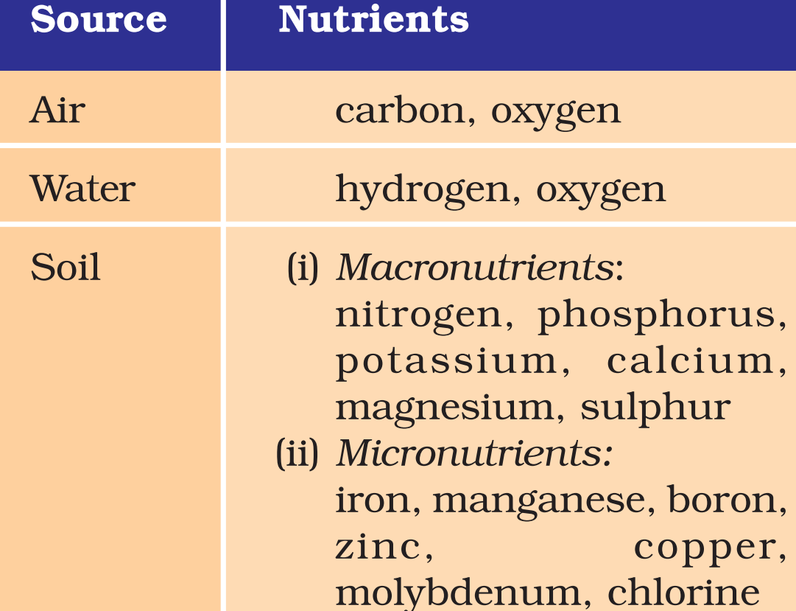
Soil-Nutrients

Slide 3
NPK: Nutrient based subsidy
Ideal N:P:K ratio should be 4: 2: 1 (N:P:K)
But in reality= 8.2: 4.2: 1
High production and usage of Urea because of high subsidy + out of NBS
Other nutrients neglected
Nitrate pollution in soil and water

Slide 4
Soil Health Cared scheme
State Governments to issue soil health cards to all farmers in the country.
Soil health card will provide information to farmers on nutrient status of their soil + recommendation on appropriate dosage of nutrients - for improving soil health and its fertility.
Soil Health status will be assessed regularly in a cycle of 3 years

Slide 5
Problems of chemical fertilizers
Soil and water pollution
Marine pollution – eutrophication – Algal bloom
High Nitrate in drinking water – stomach cancer
Unless the soil gets enough humus, chemicals harden the soil and reduce its fertility in the long run

Slide 6
Organic Farming
Paramparagat Krishi Vikas Yojana to promote organic farming
Discourage the use of chemical fertilizers and pesticides
Promote traditional practice of farming, use of bio-fertilizers, vermi-compost etc.
Sustainable method of agriculture (crop-rotation, water-efficiency)

Slide 7
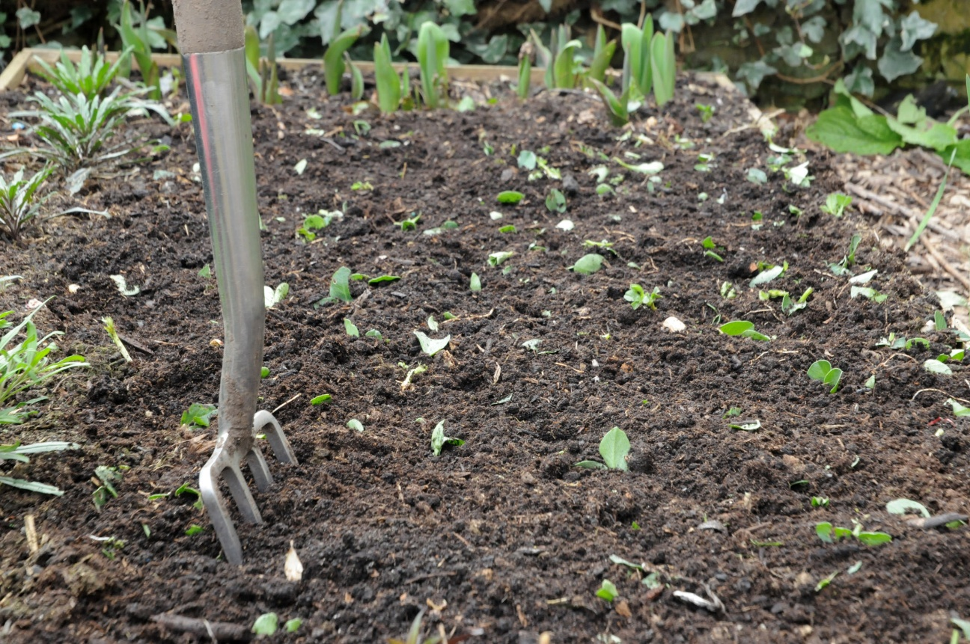
Green Manure
Prior to the sowing of the crop seeds, sun hemp or guar are grown and then mulch + ploughing them into the soil.
helps in enriching N, P in soil
Discourage weeds
Discourage leaching

Slide 8
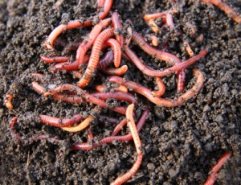
Vermi-compost
Mixture of Earth-worms + decomposed food or vegetable waste
Break down of organic matter by earth worm
Water-soluble, nutrient-rich, moist organic fertlizers

Slide 9
Benefits of Vermi-compost
Increase soil-aeration
Enrich soil with micro-organism
Improve soil water retentivity
Improve root-growth in plants
Easy to produce at affordable way

Slide 10
Agri
Crop
Land
Fin.
Mkt
Water
M/C
Nutri.
Ext.

Slide 11
After Independence
1st FYP- all the sectors of economy was given equal importance
After independence net sown area expansion till 1st FYP
Then it reached saturation – no space for more expansion
Needed focus on high productivity to increase expansion

Slide 12
During 2nd FYP
2nd FYP – Mahalanobis model – impetus to heavy industries
Agriculture was deliberately ignored
Capital industries – no immediate results – high investment, long gestation period,
1961-62 Sino-India war
Droughts
Food crisis- hunger, famine
Urged for food import from USA- PL 480

Slide 13
Green Revolution
Launched in 1965-66 as HYV program
Model: Philippines and Mexico
M.S. Swaminathan brought HYV developed by Norman Borlaug

Slide 14
Objective of Green Revolution
Manage food crisis
Develop self-sufficiency in food production
Modernization of agriculture
Develop agro-industry interface

Slide 15
Green Revolution
Level -1: modernization of agro-practice
HYV, irrigation, chemical fertilizers, pesticides, mechanization
Level -2: crop-specific, region-specific
Target: wheat crop and region: PN-HN and western UP
Farmers of this region – rich, risk taking ability, large farm size, willing to adopt new technology

Slide 16
Benefits of Green Revolution
Increase in agro-productivity
Productivity in wheat increased 4 times
Improvement in overall food-crop production
1950-51 – production was 50 ml ton
1990s – 200 ml ton
Improvement was carried out in jawar, sugarcane, potatoes
Milk, poultry, fishing

Slide 17
Benefits of Green Revolution
Boost to growth of fertilizer industries
Expansion of irrigated lands
Tube-well revolution
Roads, markets, cold storages in NW India
Not a single incidence of famine in India after Green Revolution

Slide 18
Criticism of approach of Green Revo.
Crop-specific and region-specific
Increased disparity
But that policy was according to need of the time
The mistake was - The success of green revolution was not spread to other areas

Slide 19
To spread Green Revolution in other areas
Need channels for dissemination
According to soil, climate and water-availability
Modification in technologies and selection of crop according to need of the local area
Creation of infra, regulations, monitoring, awareness

Slide 20
De-merits of Green Revolution
Inter-crop and inter-regional disparity
Pulse- millets –oil-seeds were neglected
Agro-modernization did not reached to drylands and poor regions
Large farmers became rich, small and marginal farmers neglected
Input-intensive agro-practice: excessive use of water, fertilizers – soil erosion, salinity, pollution

Slide 21
UPSC
Question
Q. Why did Green revolution in India virtually by-pass the eastern region, despite fertile soil and good availability of water? (10)
Mains
2014

Slide 22
While spreading Green Revo. - other areas
No to input intensive agriculture practice
Within the limit of local natural resources
Focus on all agro-crops + non-crop agro-activities
Encourage crop-diversification (for nutritional security)
“Evergreen Revolution” = sustainable agriculture

Slide 23
National Food security Mission
Launched in 2007
Ministry of agriculture
NFSM of 12th plan has 5 components;
1) Rice
2) Wheat
3) Pulses
4) Millets (coarse cereals)
5) Commercial crops – cotton, sugarcane and Jute

Slide 24
National Food Security Mission
Capacity Building
Targets

Slide 25
Targets under NFSM
10 mT Rice
4 mT
Pulse
3 mT
Coarse cereals
8 mT
Wheat

Slide 26
Farm Field schools
Farm mechanization
Resource conservation techniques
Efficient water application tools
Cropping system based training

Slide 27
NFSM: Capacity Building
Cluster demonstration: new techniques- direct seeded rice/line transplanting/SRI;
Demonstration on front-line technology on hybrid varieties, distribution of improved varieties/hybrids

Slide 28
For Evergreen Revolution
Agriculture
Investment
R&D
Pricing policy
Agro-trade

Slide 29
For Evergreen Revolution
Agriculture
Investment
R&D
Pricing policy
Agro-trade
Farm consolidation
FCI Reforms
APMC act
FPI
Balanced MSP
Lab to field connection
Lab to industry connection
Make in India Skill India

Slide 30
Agri
Crop
Land
Fin.
Mkt
Water
M/C
Nutri.
Ext.

Slide 31
Agricultural Extension
Agriculture education and awareness
Veterinary education and research
Information dissemination
Training and capacity building

Slide 32
Development of Agro-Extension
Farmer FIRST
Farmer-scientist linkage
Training+ demo
Student READY
Agro- education
Entrepreneur skill dev.
ARYA
Create employment opportunities for youth in agri.

Slide 33
Agri
Crop
Land
Fin.
Mkt
Water
M/C
Nutri.
Ext.

Slide 34
HYV
mechanization
fertilizers
irrigation
Soil conservation
Storage of produce

Slide 35
Finance
Kisan Credit card scheme
It gives crop loans, term-loans and consumption loans
KCC-> smart card to use as ATM
Risk coverage to KCC holder against accidental death (50k)or permanent disability (20k)

Slide 36
National crop-insurance Prog.
Merging National agriculture Insurance scheme, Weather based Crop Insurance scheme and Coconut, Palm Insurance scheme
The scheme is available for all farmers
It covers all crops – cereal, millets, pulses, horticulture, oil seeds
10% premium subsidy for small and medium farmers

Slide 37
NABARD’s initiatives
“Long Term Rural Credit Fund” for refinancing Cooperative Banks and Regional Rural Banks
“PRODUCE” - NABARD’s Producers’ Organization Development Fund for Producer’s development and upliftment
“Price Stabilization Fund” to mitigate price volatility in the agriculture produce

Slide 38
Agri
Crop
Land
Fin.
Mkt
Water
M/C
Nutri.
Ext.

Slide 39
Problems of Agro-marketing in India
Large no. of middle men
Lack of grading and standardization
Inadequate transport system
Lack of storage infra
Lack of credit facility to farmers
Lack of market info to farmers
Indian farmers receive 25% of the retail price of their produce (US farmers get 70%)

Slide 40
Solution to agro-Marketing
Kisan Mandi
Direct sale of fruits and vegetables by farmers to consumers
FPO
Direct marketing of produce
Unified National Market
Elimination of inter-state barriers
Amend APMC Act
Direct contract farming
Cooperative marketing

Slide 41
Unified National Market
Sarkaria commission and Punchi commission recommended inter-state trade and commerce commission
SC in Atiabari tea co. Vs state of Assam = free movement and exchange of goods throughout the territory of India is essential for the economy of the nation and for sustaining and improving living standards of the people

Slide 42
Storage Infrastructure
Grameen Bhandaran Yojana
Private Entrepreneurs Guarantee scheme by FCI
For construction of go-downs through PPP
Guarantee full capacity rents for 10 years
Storage capacity should be enough to meet 4 months’ requirement of PDS
100% FDI allowed in warehouse development

Slide 43
Storage Infrastructure
Warehouses, private or of CWC or SWC, have to be registered with WDRA whichever want to issue warehouse negotiable receipt
The ware house receipt is a tool for trade at commodity exchange or to get loans at commercial rates.
Benefits of receipt encourage farmers to store their produce in warehouse

Slide 44
Marketing
Forward Market Commission (FMC) has set up e-portal AGMARKNET
Real time whole sale prices of agricultural commodities on the e-portal
Connected with most of the APMC markets, mandis and Kisan Vikas Kendras, state agriculture marketing boards

Slide 45
Agri
Crop
Land
Fin.
Mkt
Water
M/C
Nutri.
Ext.

